Slide 1
Playfair ciphers
Matrix-based block cipher used in WWI
In a 5x5 matrix, write the letters of the word “playfair” (for example) without dups, and fill in with other letters of the alphabet, except I,J used interchangeably.

Slide 2
Playfair encryption
Break plaintext into letter pairs
If a pair would contain double letters, split with x
Pad end with x
hellothere becomes…
he lx lo th er ex
For each pair,
If they are in the same row, replace each with the letter to its right (mod 5)
he → KG
If they are in the same column, replace each with the letter below it (mod 5)
lo → RV
Otherwise, replace each with letter we’d get if we swapped their column indices
lx →YV
He lx lo th er ex
KG YV RV QM GI KU
To decrypt, just reverse!

Slide 3
Weaknesses
P is unknown, but structure of its bottom is predictable
Can break using digram frequencies
Example: If a digram and its reverse both appear often, it’s probably ER and RE.
Each plaintext letter maps to how many possible ciphertext letters?
He lx lo th er ex
KG YV RV QM GI KU
Notes:
Maps to 5 letters

Slide 4
Playfair ciphers
Used in Dorothy L. Sayers’ 1932 mystery novel Have His Carcase
Marketing beats technology?
Invented by Charles Wheatstone
Lyon Playfair, a Scottish Baron, promoted it
Who got the glory?

Slide 5



Multiplicative Substitution Cipher
Encryption
Decryption
P : Plaintext K: key C: Ciphertext
: Inverse Multiplicative key

Slide 6
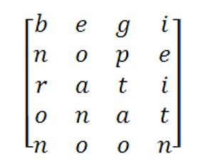
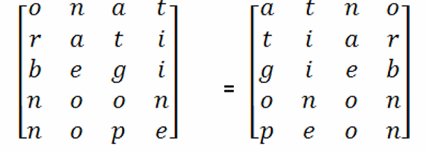
Elementary Transposition Ciphers •
The transposition ciphers shuffles, rearranges or permutes the character in a block of plain text.
Plain Text :
“Begin Operation at Noon” ( width of the rows and
permutations of columns
defined by keyword)
Rearrange the rows 1 -> 3, 2 - > 5, 3 - > 2, 4 - > 1, 5 -> 4
Rearrange the columns 1 -> 4, 2 - > 3, 3 - > 1, 4 - > 2
Resulting matrix =
Cipher text : A TN OTIARGIEBONONPEON

